Slide 1
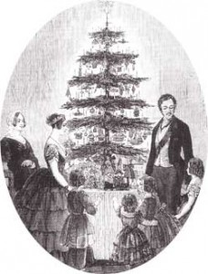
Did you know?
Before 1837, England didn’t have Christmas trees, send Christmas cards nor decorate their homes at Christmas time!
Queen Victoria’s husband, Albert, brought these traditions with him from Germany!

Slide 2
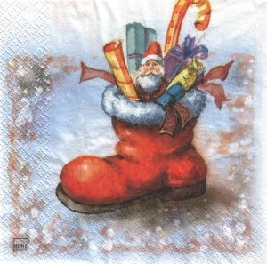
Nikolaustag
Christmas celebrations in Germany begin on December 6^{th,} Nikolaustag (St. Nicholas day). Children leave a shoe or boot outside the door the night before and the next morning find
presents (if you were good) or a
stick (if you were bad)!

Slide 3
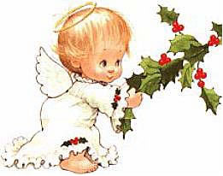
Christkind
In parts of Germany, people believe that the Christ Child sends a messenger on Christmas Eve. He appears as an angel in a white robe and crown, bearing gifts.

Slide 4
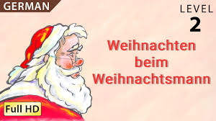
Weinachtsmann
In other parts of Germany, “Christmas Man,” or Santa Claus brings presents on Christmas Eve.

Slide 5
Das Adventkranz
Households in Germany set out advent wreaths of Holly with four red candles in the center. They light one candle each Sunday and the last one on Christmas Eve.

Slide 6
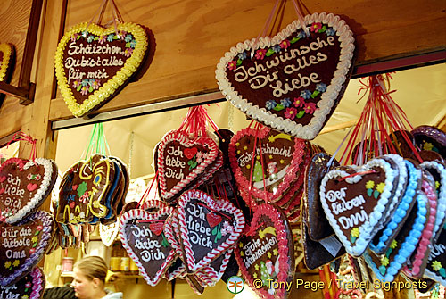
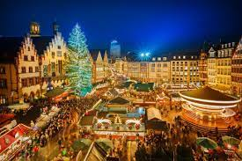
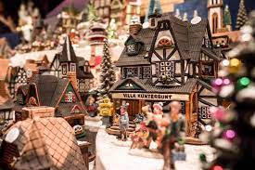
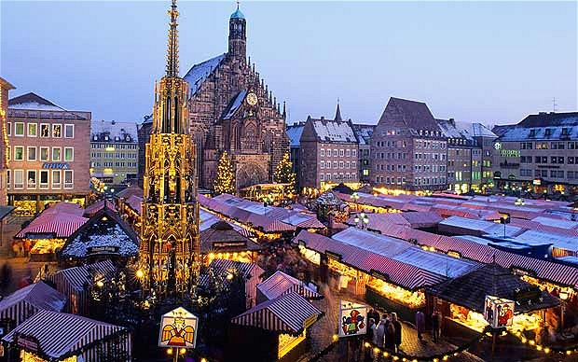
Weinachtsmarkt
Each German town has a Christmas market where festive foods and drink, decorations and presents are sold. They are world famous!

